Slide 1
Content-Based Image Retrieval
Dr. Ramprasad Bala
Computer and Information Science
UMASS Dartmouth
CIS 585 – Image Processing and Machine Vision

Slide 2
Image Databases
Image databases, once an expensive proposition, in terms of space, cost and time has now become a reality.
Image databases, store images of a various kinds.
These databases can be searched interactively, based on image content or by indexed keywords.

Slide 3
Examples
Art collection – paintings could be searched by artists, genre, style, color etc.
Medical images – searched for anatomy, diseases.
Satellite images – for analysis/prediction.
General – you want to write an illustrated report.

Slide 4
Database Projects
IBM Query by Image Content (QBIC).
  Retrieves based on visual content, including properties such as color percentage, color layout and texture.
  Fine Arts Museum of San Francisco uses QBIC.
Virage Inc. Search Engine.
  Can search based on color, composition, texture and structure.

Slide 5
Commercial
Corbis – general purpose, 17 million images, searchable by keywords.
Getty Images – image database organized by categories and searchable through keywords.
The National Laboratory of Medicine – database of X-rays, CT-scans MRI images, available for medical research.
NASA & USGS – satellite images (for a fee!)

Slide 6
Image Databases
Images appearing on the WWW typically contain captions from which keywords can be extracted.
In relational databases, entries can be retrieved based on the values of their textual attributes.
Categories include objects, (names of) people, date of creation and source.
Indexed according to these attributes.

Slide 7
Image Database Queries
  SELECT * FROM IMAGEDB
  WHERE CATEGORY = ‘GEMS’
    AND
  SOURCE = ‘SMITHSONIAN’

Slide 8
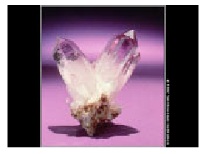
The query would look in the image DB where the source has been set to Smithsonian.
All images that have ‘Gems’ in them would be retrieved.
To make finer searches KEYWORD can be used.

Slide 9
Image Database Queries
  SELECT * FROM IMAGEDB
  WHERE CATEGORY = ‘GEMS’
  AND
  SOURCE = ‘SMITHSONIAN’
  AND
  (KEYWORD = ‘AMETHYST’ OR
  KEYWORD = ‘CRYSTAL’ OR
  KEYWORD = ‘PURPLE’)

Slide 10
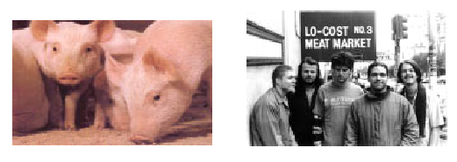
Keyword Searches
Keyword searches can be very limiting.
First they have to be indexed – which can be quite expensive.
HTML title keywords can be used for searching but can be misleading. (Eg. ‘pigs’)

Slide 11
Query by Example
QBE is database terminology for a query that is formulated by filling values and constraints in a table and can be converted by a system to SQL.
Microsoft Access is an example.
Provides an convenient interface to a relational database.

Slide 12
QBE in image database
Instead of typing a query, the user can show an image that would be matched or even paint a shape for matching.
The system should be able to return similar images containing the sample image or sample shape.
This is the goal of Content-based image retrieval.

Slide 13
CBIR
Generally speaking, consider a query with an example image plus a set of constrains. The image could be :
  digital photograph
  user-painted sketch
  A line drawing
  Empty
In the last case the DB will return all the images that meet the constraints.

Slide 14
CBIR
The constraints may be
  Keywords that should be present in some indexing system
  Specification of objects that should be present
  Even spatial relationships among them.
Typically the query is a digital image that is compared to images the DB based on some image distance measure.

Slide 15
CBIR
When the image distance measure is zero the image exactly matches the query.
Values larger than zero indicate various degrees of similarity to the query.
Image search engines return a set of images in order of their distance to the query.

Slide 16
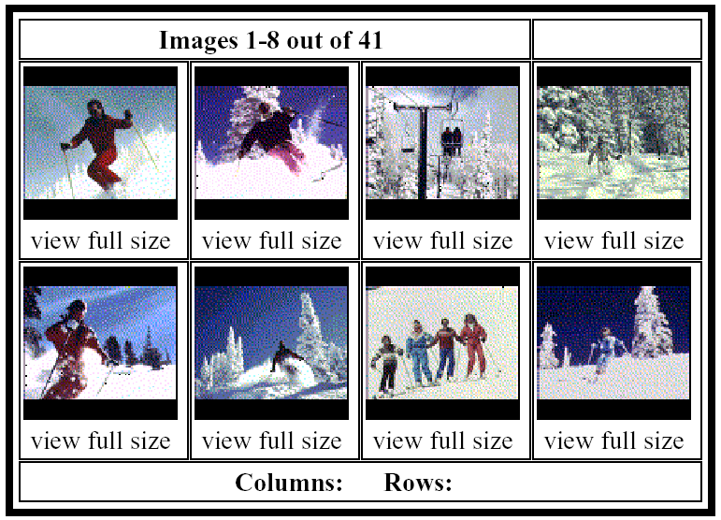

Slide 17
Image Distance Measures
The judgment of how similar a database image is to a query id dependent on which image distance measure is used.
There are four major classes
  Color similarity
  Texture similarity
  Shape similarity
  Object and relationship similarity.

Slide 18
Color Similarity Measures
Compare the color content of one image with the color content of a second image.
For example QBIC allows users to specify a query in terms of color percentages.
The user can choose up to five colors and their percentages.
The spatial distribution of these colors is not relevant.

Slide 19
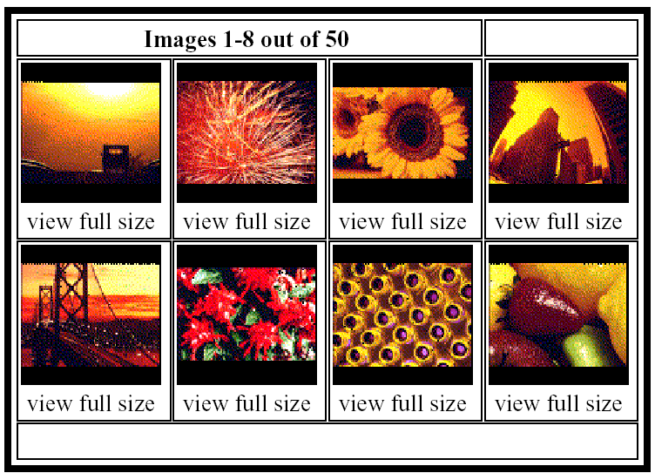
Images returned for 40% red, 30% yellow and 10% black.

Slide 20
Color Similarity Measures
Color histogram matching could be used as described earlier.
QBIC defines its color histogram distance as
d_{dist} (I,Q) = (h(I) – h(Q))^{T}A(h(I) – h(Q))
where h(I) and h(Q) are the K-bin histogram of images I and Q respectively and A is a KxK similarity matrix.
In this matrix similar colors have values close to1 and colors that are different have values close to 0.

Slide 21
Color Similarity Measures
Color layout is another possible distance measure.
The user can specify regions with specific colors.
Divide the image into a finite number of grids. Starting with an empty grid, associate each grid with a specific color (chosen from a color palette.

Slide 22
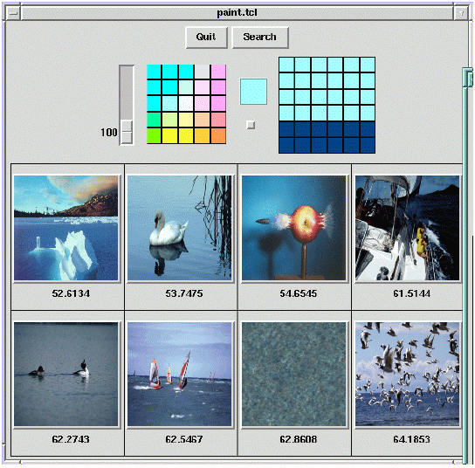

Slide 23
Color Similarity Measures
It is also possible to provide this information from a sample image. As was seen in Fig 8.3.
Color layout measures that use a grid require a grid square color distance measure d_{color} that compare the grids between the sample image and the matched image.
d_{gridded_square} (I,Q) = Σ d_{color}(C^{I}(g),C^{Q}(g))
g

Slide 24
Where C^{I}(g) and C^{Q}(g) represent the color in grid g of a database image I and query image Q respectively.
The representation of the color in a grid square can be simple or complicated.
Some suitable representations are
  The mean color in the grid square
  The mean and standard deviation of the color
  A multi-bin histogram of the color
These should be assigned meaning ahead of time, i.e. mean color could mean representation of the mean of R, G and B or a single value.

Slide 25
Texture Similarity Measures
Texture similarity tends to be more complex use than color similarity.
An image that has similar texture to a query image should have the same spatial arrangements of color, but not necessarily that same colors.
The texture measurements studied in the previous chapter can be used for matching.

Slide 26
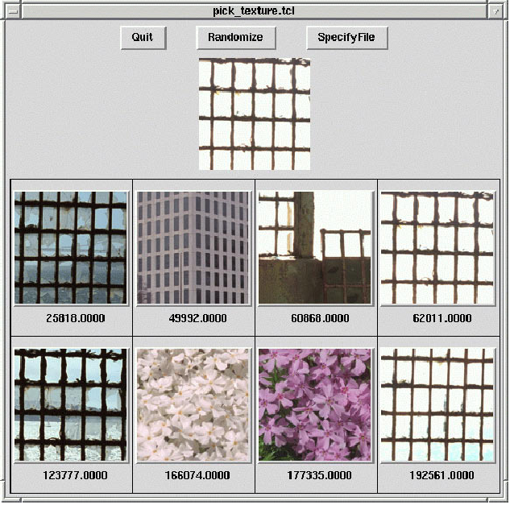

Slide 27
Texture Similarity Measures
In the previous example Laws texture energy measures were used.
As can be seen from the results, the measure is independent of color.
It also possible to develop measures that look at both texture and color.
Texture distance measures have two aspects
  The representation of texture
  The definition of similarity with respect to that representation

Slide 28
Texture Similarity Measures
The most commonly used texture representation is a texture description vector, which is a vector of numbers that summarizes the texture in a given image or image region.
The vector of Haralick’s five co-occurrence-based texture features and that of Laws’ nine texture energy features are examples.

Slide 29
Texture Similarity Measures
While a texture description vector can be used to summarize the texture in an entire image, this is only a good method for describing single texture images.
For more general images, texture description vectors are calculated at each pixel for a small (e.g. 15 x15) neighborhood about that pixel.
Then the pixels are grouped by a clustering algorithm that assigns a unique label to each different texture category it finds.

Slide 30
Texture Similarity Measures
Several distances can be defined once the vector information is derived for an image. The simplest texture distance is the pick-and-click approach, where the user picks the texture by clicking on the image.
The texture measure vector is found for the selected pixel and is used to measure similarity with the texture measure vectors for the images in the database.

Slide 31
Texture Similarity Measures
The texture distance is given by
d_{pick_and_click}(I,Q) = min _{i in I} ||T(i) – T(Q)||²
where T(i) is the texture description vector at pixel I of the image I and T(Q) is the textue description vector at the selected pixel (or region).
While this could be computationally expensive to do on the fly, prior computation (and indexing) of the textures in the image database would be a solution.

Slide 32
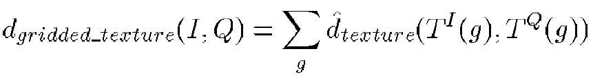
Alternate to pick-and-click is the gridded approach discussed in the color matching.
A grid is placed on the image and texture description vector calculated for the query image. The same process is applied to the DB images.
The gridded texture distance is given by
Where d_{texture} can be Euclidean distance or some other distance metric.

Slide 33
Shape Similarity Measures
Color and texture are both global attributes of an image.
Shape refers to a specific region of an image.
Shape goes one step further than color and texture in that it requires some kind of region identification process to precede the shape similarity measure.
Segmentation is still a crucial problem to be solved.
Shape matching will be discussed here.

Slide 34
Shape Similarity Measures
2-D shape recognition is an important aspect of image analysis.
Comparing shapes can be accomplished in several ways – structuring elements, region adjacency graphs etc.
They tend to expensive in terms of time.
In CBIR we need the shape matching to be fast.
The matching should also be size, rotational and translation invariant.

Slide 35
Shape Histogram
Histogram distance simply an extension from color and texture.
The biggest challenge is to define the variable on which the histogram is defined.
One kind of histogram matching is projection matching, using horizontal and vertical projections of the shape in a binary image.

Slide 36
Projection Matching
For an n x m image construct an n+m histogram where each bin will contain the number of 1-pixels in each row and column.
This approach is useful if the shape is always the same size.
To make PM size invariant, n and m are fixed
Translation invariance can be achieved in PM by shifting the histogram from the top-left to the bottom-right of the shape.

Slide 37
Projection Matching
Rotational invariance is harder but can be achieved by computing the axes of the best fitting ellipse and rotate the shape along the major axis.
Since we do not know the top of the shape we have to try two orientations.
If the major and minor-axes are about the same size four orientations are possible.

Slide 38
Projection Matching
Another possibility is to construct the histogram over the tangent angle at each pixel on the boundary of the shape.
This is automatically size and translation but not rotation invariant.
The rotational invariance can be solved by rotating the histogram (K possible rotations in a K-bin histogram).

Slide 39
Boundary Matching
BM algorithms require the extraction and representation of the boundaries of the query shape and image shape.
The boundary can be represented as a sequence of pixels or maybe approximated by a polygon.
For a sequence of pixels, one classical matching technique uses Fourier descriptors to compare two shapes.

Slide 40
Boundary Matching
In the continuous case the FDs are the coefficients of the Fourier series expansion of the function that defines the boundary of the shape.
In the discrete case the shape is represented by a sequence of m points <V₀, V₁, …,V_{m-1}>.
From this sequence of points a sequence of unit vectors and a sequence of cumulative differences can be computed

Slide 41
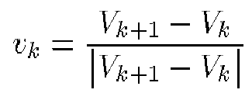
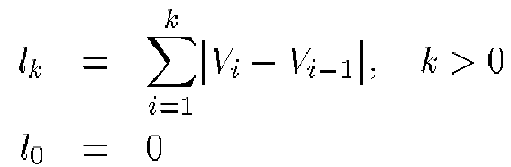
Boundary Matching
Unit vectors –
Cumulative differences

Slide 42
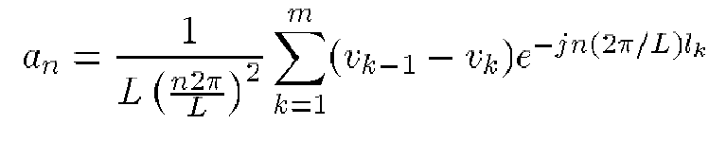
Boundary Matching
The Fourier descriptors {a_{-M}, …, a₀, …,a_{M}}
are then approximated by
These descriptors can be used to define a shape distance measure.

Slide 43
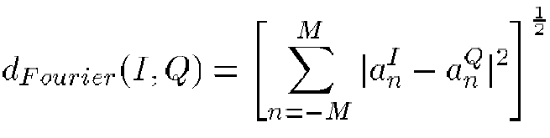
Boundary Matching
Suppose Q is the query shape and I is the image shape. Let {a_{n}^{Q}} be the sequence of FDs for the query and {a_{n}^{I}} be the sequence of FDs for the image.
The the Fourier distance measure is given by

Slide 44
Boundary Matching
This measure is only translation invariant.
Other methods can be used in conjunction with this to solve other invariances.
If the boundary is represented by polygons, the lengths and angles between them can be used to compute and represent the shapes.

Slide 45
Boundary Matching
Another boundary matching technique is elastic matching in which the query shape is deformed to become as similar as possible to the image shape.
The distance between the query shape and image depends on two components :
  The energy required to deform the query shape
  A measure of how well the deformed shape actually matches the image.

Slide 46
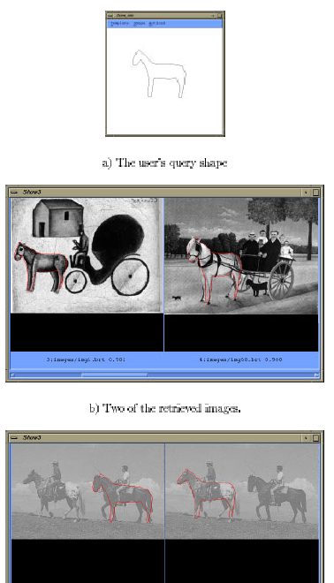

Slide 47
Sketch Matching
Sketch matching systems allow the user to input a rough sketch of the major edges in an image and look for matching images.
In the ART MUSEUM system, the DB consists of color images of famous paintings. The following preprocessing step are performed to get an abstract image of all the images in the DB.

Slide 48
An affine transform is applied to reduce the image to a standard size, such as 64x64 and median filter is applied to remove noise. The result is a normalized image.
Detect edges based on gradient-based edge-finding algorithm. This is done using two steps – major edges are found with a global threshold that is based on the mean and variance of the gradient; then the local edges are selected from the global edges by local threshold. The result is a normalized image.
Perform thinning and shrinking on the refined edge image. The final result is an abstract image.

Slide 49
Sketch Matching
When the user enters a rough sketch, it is also converted to the normalized size, binarized, thinned and shrunk, resulting in a linear sketch.
Now the linear sketch must be matched to the abstract image.
The matching algorithm is (gridded) correlation-based.

Slide 50
Face Finding
Face finding is both useful and difficult.
Faces can vary is size and spatial location in an image.
A system developed at CMU employs a multi-resolution approach to solve the size problem.
The system uses a neural-net classifier that was trained on 16,000 images to segment faces from non-faces.

Slide 51
Flesh Finding
Another way of finding objects is to find regions in images that have the color and texture usually associated with that object.
Fleck, Forsyth and Bregler (1996) used this to find human flesh –
  Finding large regions of potential flesh
  Grouping these regions to find potential human bodies.

Slide 52
Spatial Relationship
Once objects can be recognized, their spatial relationships can also be determined.
Final step in the image retrieval hierarchy.
Involves in segmenting images into regions that often correspond to objects or scene background.
A symbolic representation of the image in which the regions of interest are depicted can be extracted. This can be useful in understanding spatial relationships of the objects with background.

Slide 53
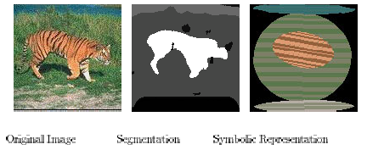
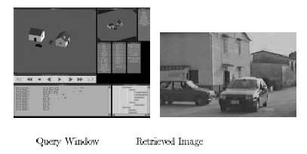

Slide 54
Database Organization
Large databases of images are usually too big to search the whole database for images that satisfy a given query.
Instead, the images must be organized and indexed so that only a fraction of them are even considered for any query.
Methods of indexing images for CBIR are being developed.

Slide 55
Standard Indexes
In most relational DB, the user can specify an attribute on which an index is to be built, usually an key associated with each record.
In a relational DB, an index is a data structure with which the system can look up a given attribute. There are two common types of indexes – hash indexes and B-tree indexes.

Slide 56
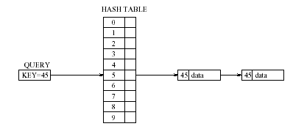
Hash Indexes
A hash index applies the theory of the hash table to access a large set of records in a DB.

Slide 57
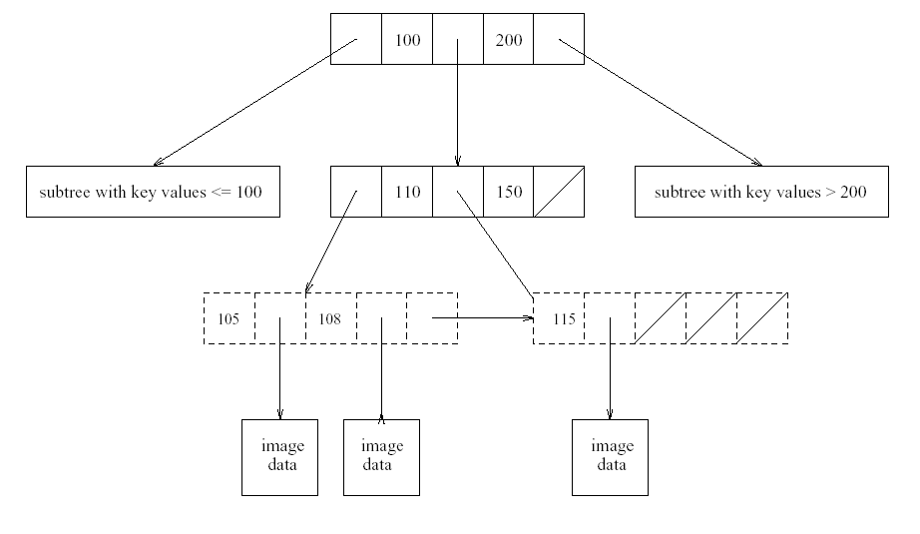
B-trees and B⁺-trees are balanced multi-way search trees that can be used for indexing and suitable for range queries.

Slide 58
Spatial Indexing
Spatial information systems contain data that is multi-dimensional.
Quadtrees are hierarchical structures of degree four that break up the search space for 2D data into four sub-quadrants at each level of the tree.

Slide 59
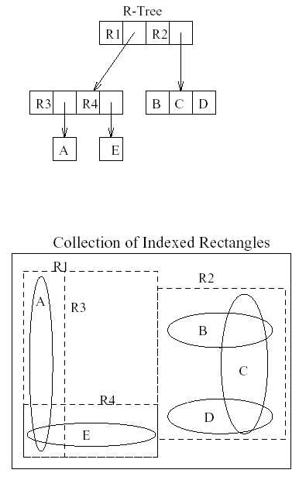

Slide 60
Indexing for CBIR
The above methods can be used to index for retrieval via simple distance measures that are based on single attribute.
In large systems that provide multiple distance measures, a more complex organization and indexing would be required.

Slide 61
Pattern Recognition

